Slide 1
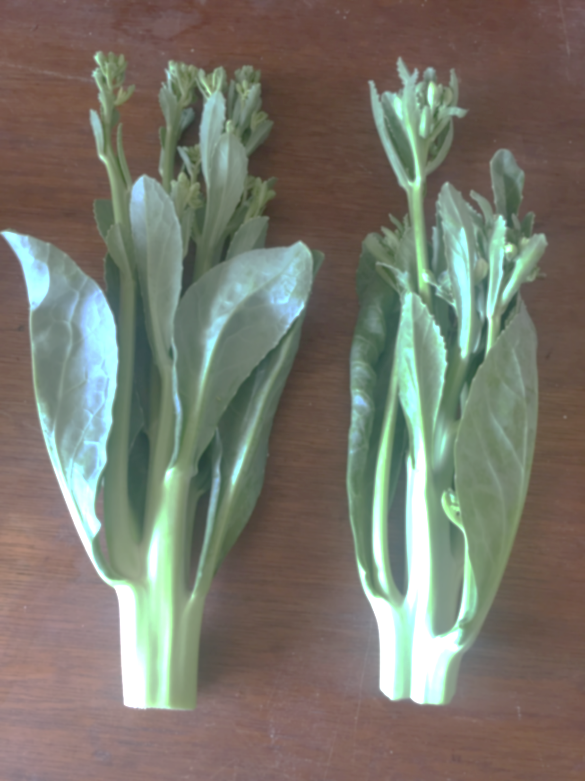
Chines Kale / Chinese Broccoli
a.k.a
Kailan or Gailan
Brassica oleracea
Cultivar group: alboglabra
Same species as head cabbage, broccoli, cauliflower

Slide 2
Brassica oleracea
Includes many cultivars
Wild cabbage, wild mustard
Head cabbage
Chinese kale
Common broccoli
Collard greens
Common kale
Brussels sprout
Cauliflower
And more

Slide 3
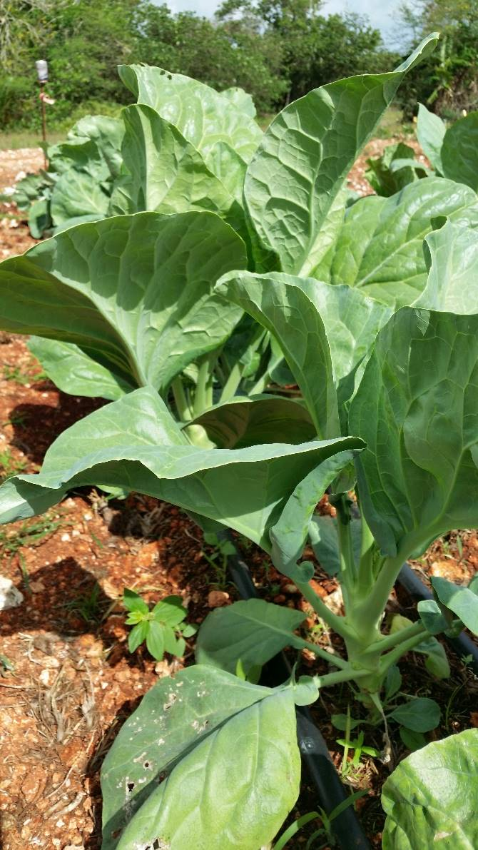
Origin and General Characteristics
vegetable crop that originated in China.
similar to western broccoli in appearance, and is thus known as Chinese broccoli.
Slightly bitter but sweeter than western broccoli

Slide 4
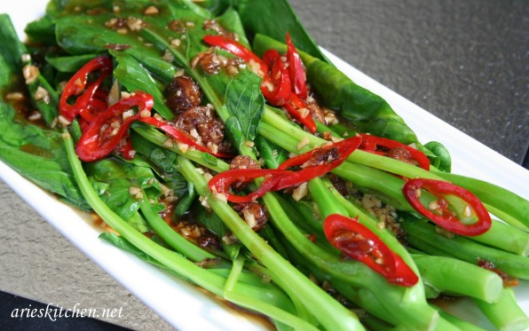
Kailan uses
Stir-Fry

Slide 5
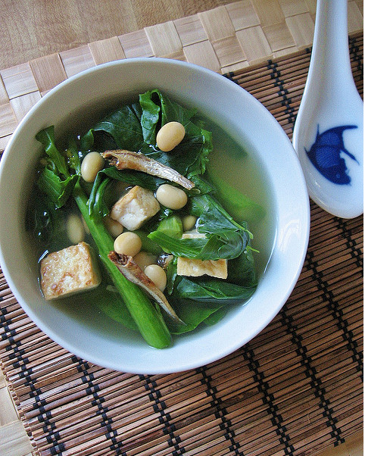
Kailan uses
Soups
http://teczcape.blogspot.com/2013/01/gai-lan-chinese-broccoli-soup.html

Slide 6
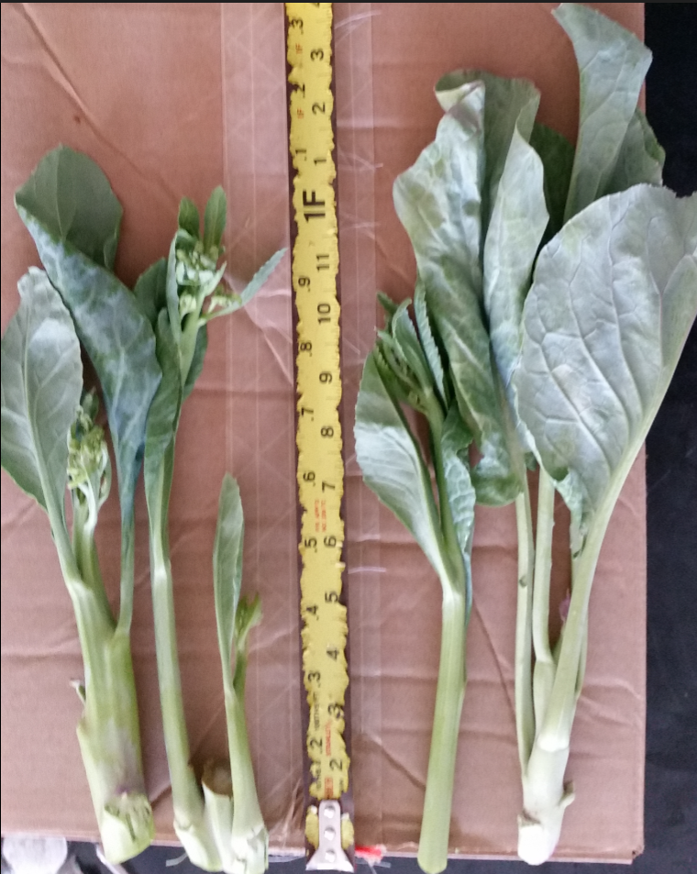
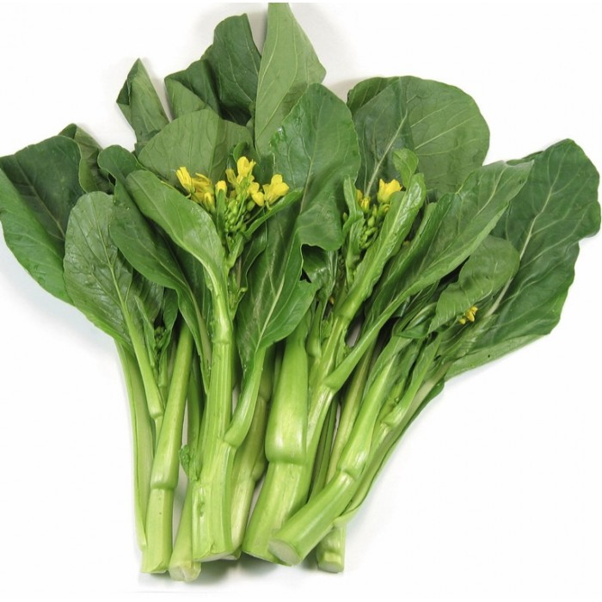
Kailan uses
Fresh Greens (young leaves and stalks with forming flowers)
http://www.theseedsmaster.com/index.php?route=product/product&product_id=633

Slide 7
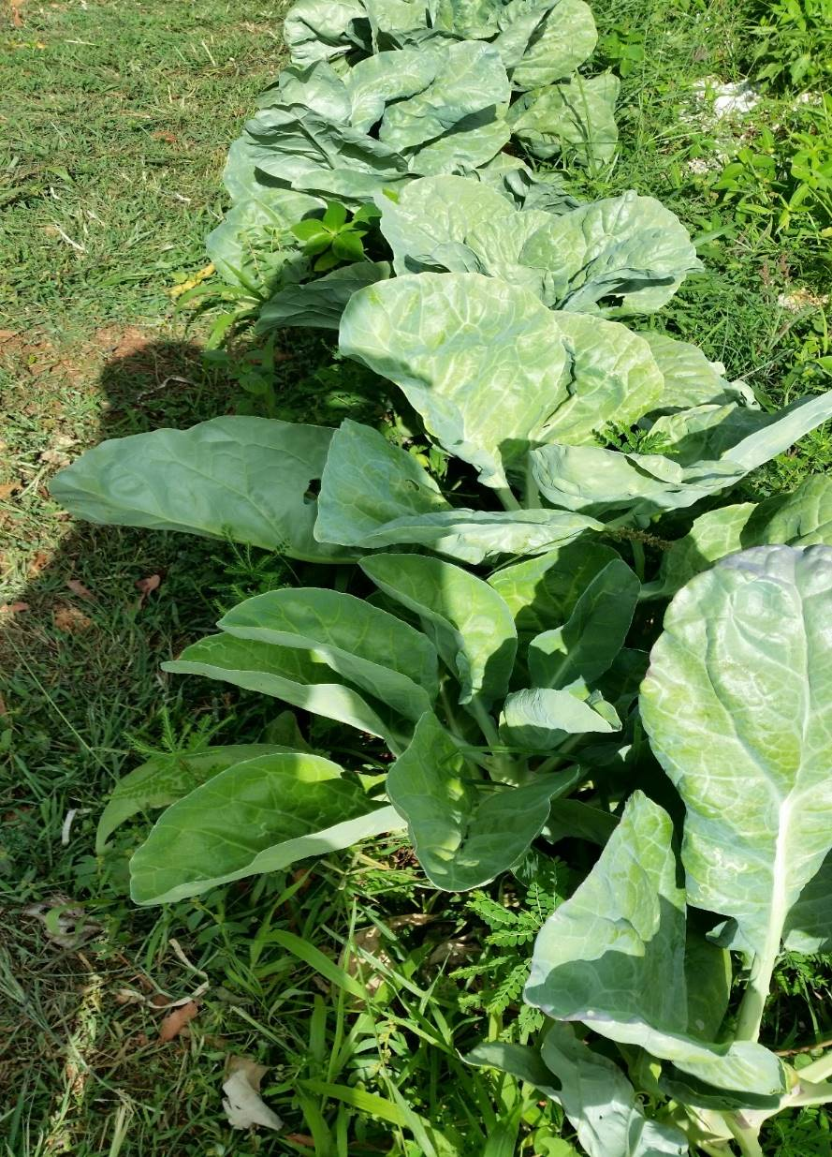
Nutrition: Rich in
Vitamin A
Vitamin C
Vitamin K
Folic Acid
Calcium
Dietary Fiber

Slide 8
Growing Kailan
Transplanted or Direct-seeded
Young leaves 50-70 days to harvest from sprout
Can be planted at 6” apart initially for leaf growth and harvest and thinned to 1-2’ apart for stalk harvest.
Initial Bolts (stalks/tips with flower heads) 80-95 days to harvest from sprout (heaviest harvest)
Generally weekly harvest of new bolts following initial harvest can continue starting 1 week after first harvest (lighter harvests)
Plants can produce quality harvest for at least for 2 months
Is a perennial plant, but commercially grown as an annual crop (1 growing season)
Grow best in temperatures of 64-83°F. Can tolerate Guam’s hotter temperatures.

Slide 9
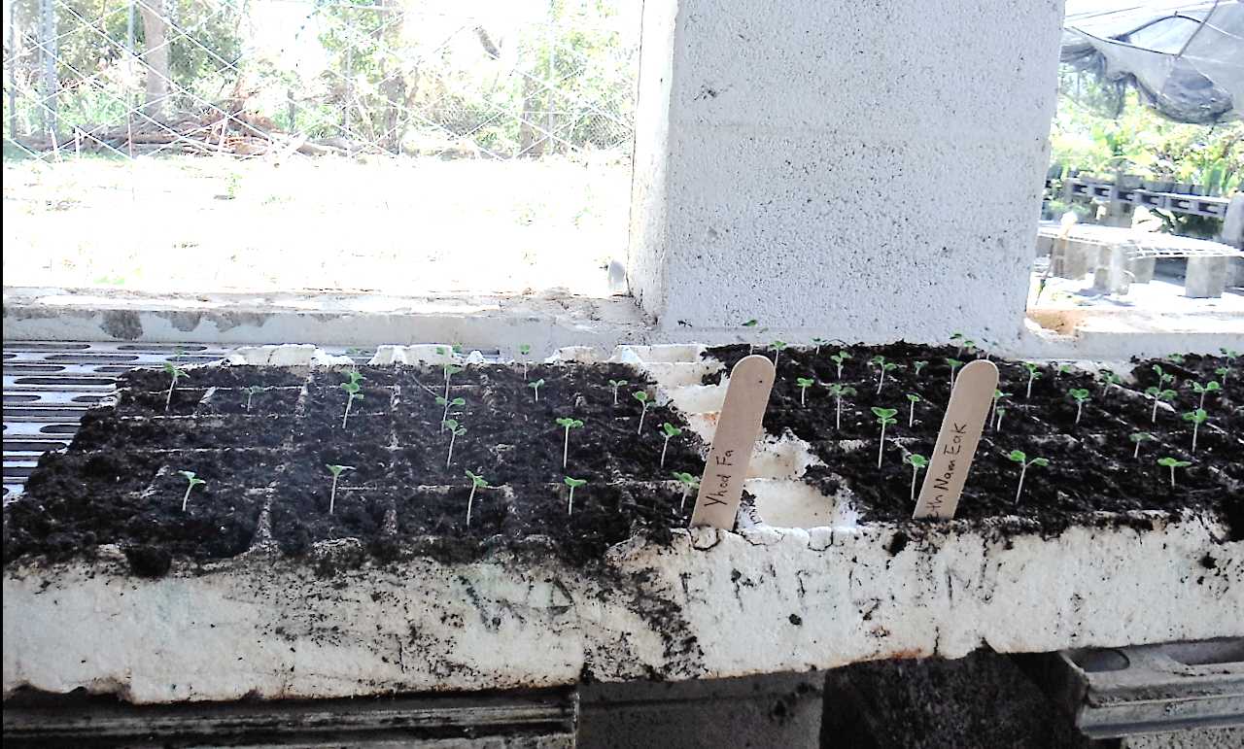
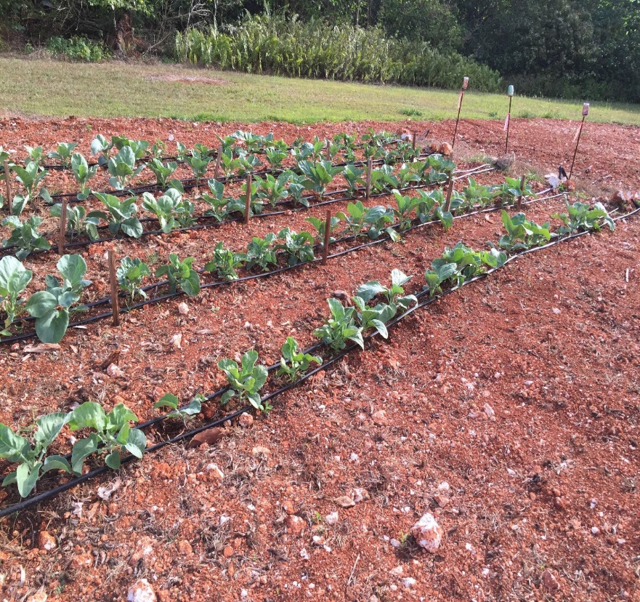
Growing Kailan

Slide 10
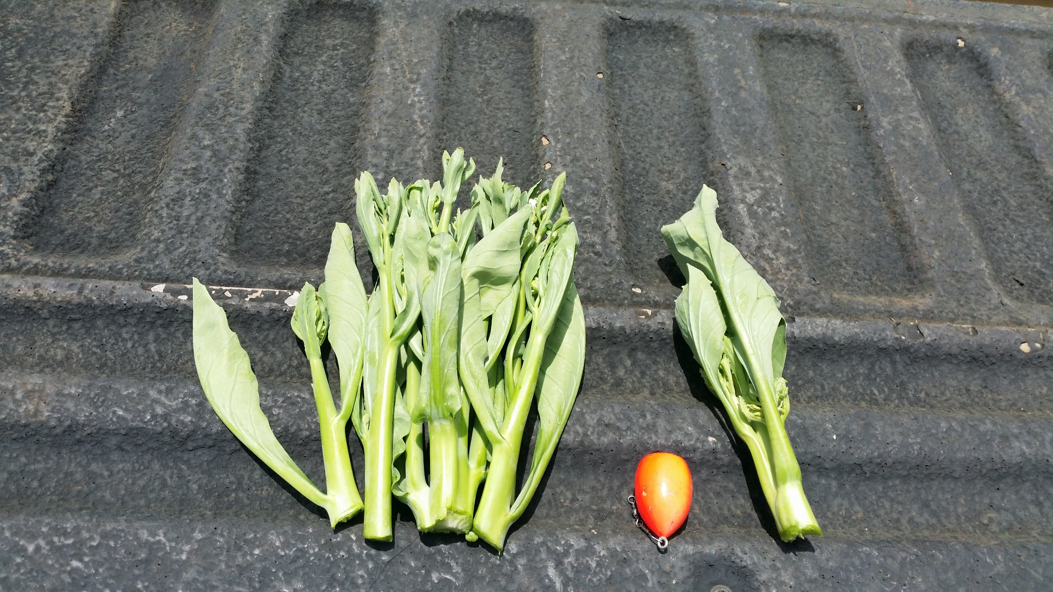
1st harvest 2nd harvest

Slide 11
Plant care
Ensure soil is moist most of the time, not saturated
Well-draining soils are best
For small-scale, any complete fertilizer can be used, but should be applied appropriately
Commercial - General Fertilizer recommendation
500 lbs of 8:11:10 (N-P-K) per acre
1 lb of 8:11:10 (N-P-K) per 100 sq ft.
Consult with local cooperative extension service

Slide 12
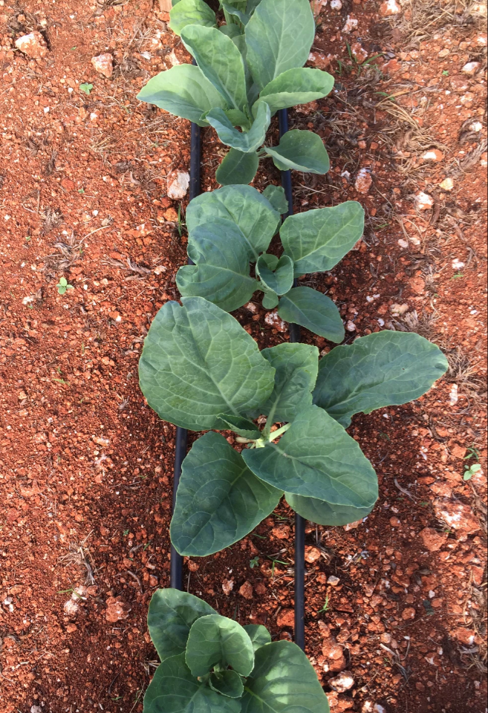
Plant care
Monitor for pest and diseases
Collect samples if possible
Consult with knowledgeable professional on pest and disease management
Weeding, mulching recommended
Good record-keeping

Slide 13
Post Harvest
Like most cabbage family, Kailan should be cooled immediately after harvest
Stored at 33-39°F to slow down water loss and decay
Avoid loosing moisture in storage rooms
This will provide a longer shelf life in stores

Slide 14
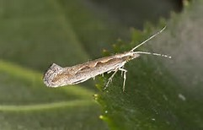
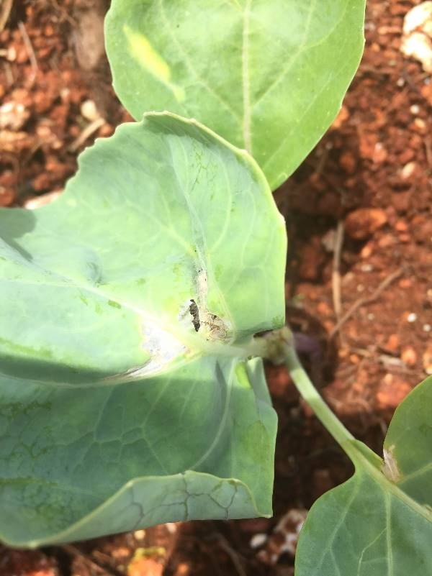
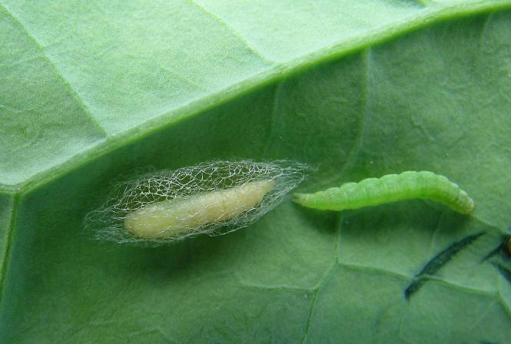
Common pests
Diamondback Moth
Aphids
https://en.wikipedia.org/wiki/Diamondback_moth
https://www.gov.mb.ca/agriculture/crops/miu/2011/2011-07-25/images/01.jpg

Slide 15
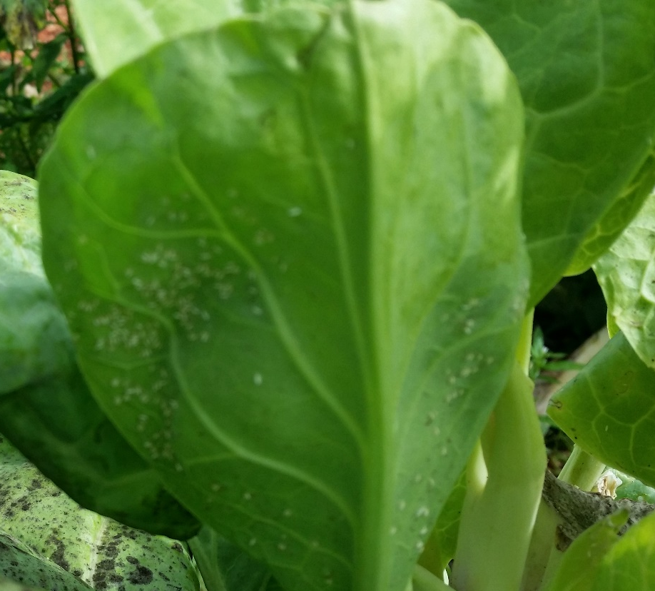
Common pests
Whitefly

Slide 16
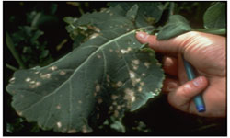
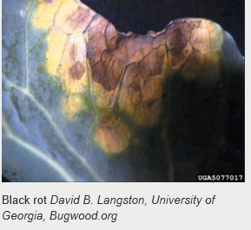
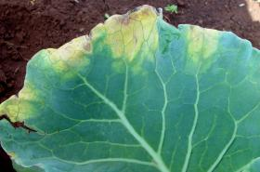
Common diseases
Fungi
Leaf spot
Black rot
http://agriculture.vic.gov.au/agriculture/pests-diseases-and-weeds/plant-diseases/grains-pulses-and-cereals/canola-diseases

Slide 17
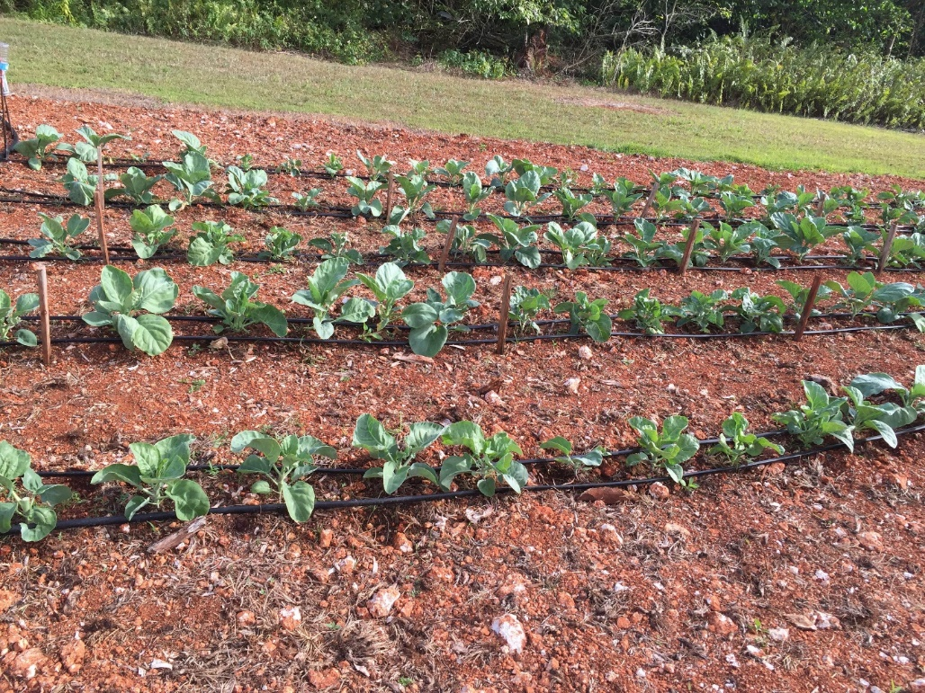
HATCH Project
Evaluation of 4 Chinese Brocolli varieties on Guam Cobbly Clay soil, a common cultivated soil. Focusing on yield (weight/marketability)
Western Pacific Tropic Research Center, Yigo Agricultural Experiment Station, College of Natural and Applied Sciences, University of Guam
On March 24, 2016, transplanted in Guam Cobbly Clay Loam soil, a commonly cultivated soil in northern Guam, after growing in plant trays for 14 days

Slide 18
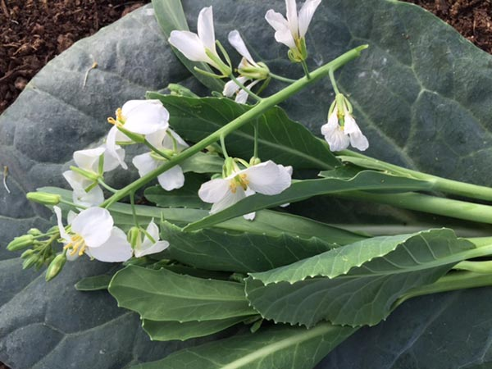
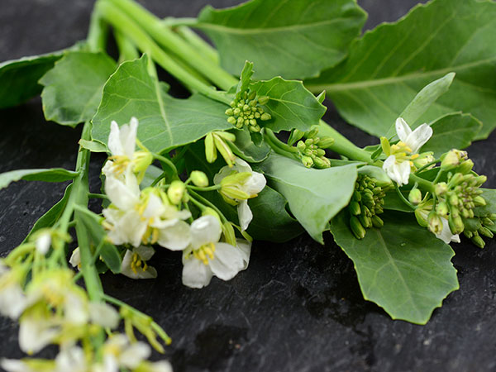
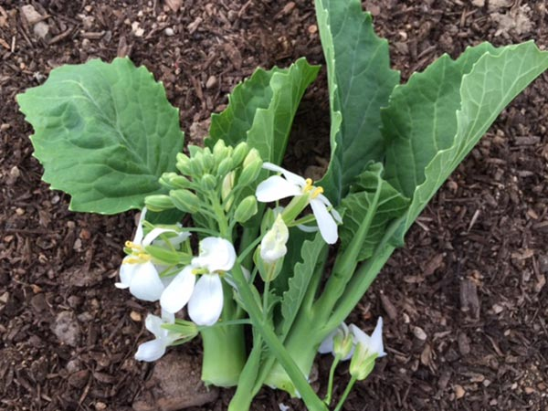
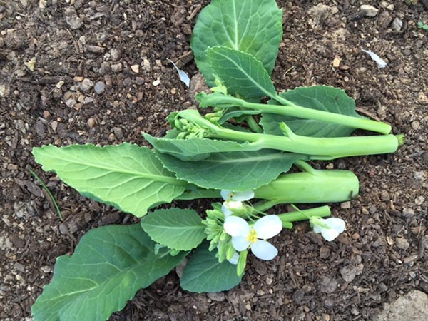
Chinese broccoli varieties
Peth Nam Eak (Bayer Creek Heirloom seeds)
Green Leaf Gailan (Bayer Creek Heirloom seeds)
Emperor (Bayer Creek Heirloom seeds)
Yhod Fa (Bayer Creek Heirloom seeds)

Slide 19
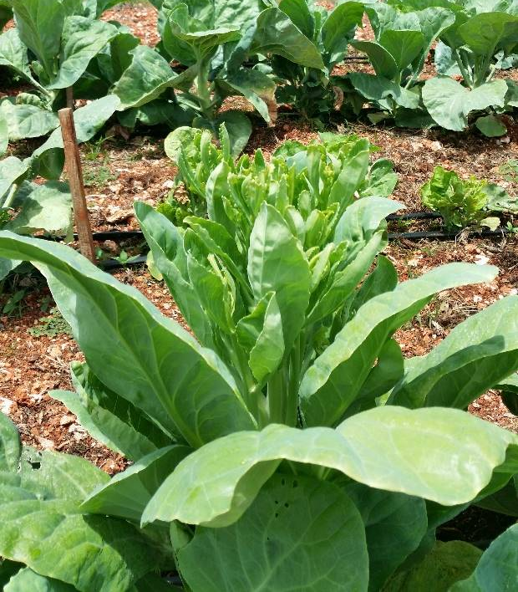
Evaluation
Green Leaf from transplant- 54
Yhod Fa, Peth Nam Eak, and Emperor from transplant- 54

Slide 20
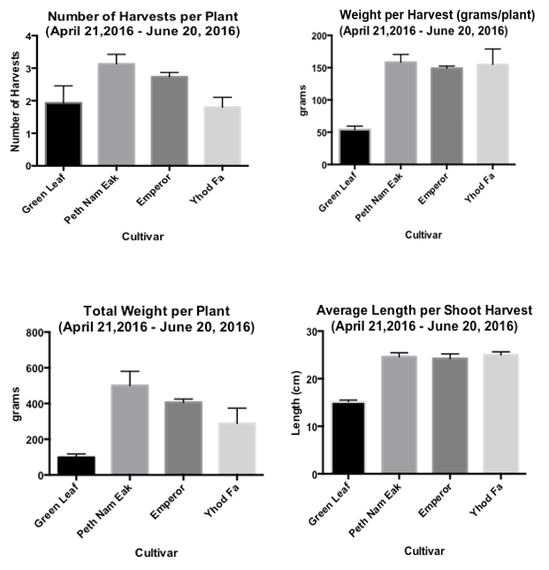
Harvest data

Slide 21
Recommended Varieties
For home gardens – All
Commercial – All except Green Leaf
Early harvest, but Small bolts/shoots

Slide 22
Other Recommendations
Choose disease and heat resistant varieties
Survey needed to evaluate marketability of Chinese kale
Best grown in fertile, well-draining soils
Monitor for pest and diseases

Slide 23
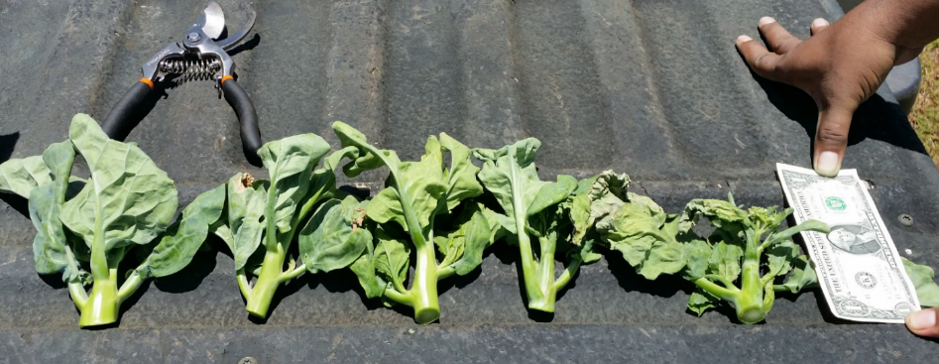

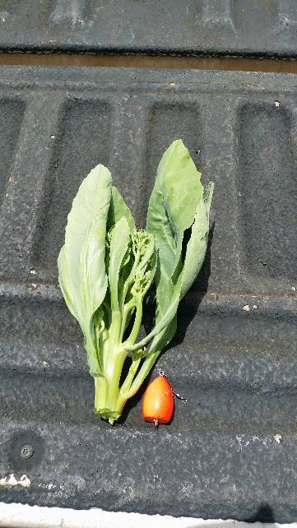
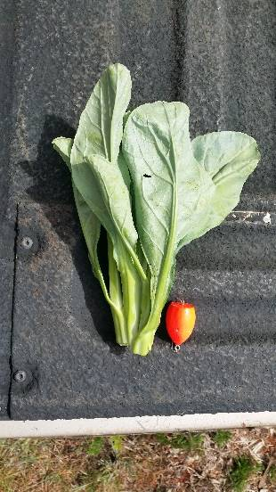
Green Leaf, early harvest, small/light weight
Peth Nam Eak
Yhod Fa
Emperor

Slide 24
References
in Miami-Dade County, Florida. University of Florida IFAS Extension. 2015.
Masabni, M. 2014. Chinese Kale (Kailaan): Vegetable Resources http://aggie-horticulture.tamu.edu/vegetable/guides/specialty-vegetables/chinese-kale-kailaan/. (Accessed July 29, 2016).
Morgan, W. and Midmore, D. 2003. Chinese Broccoli (Kailaan) in Southern Australia. A report for the Rural industries Research and Development Corporation. RIRDC Publication No 02/161. 38 p

